Slide 1
Hardening application security with SGX
Introductory Presentation, Master’s Thesis
Operating Systems and Middleware Group, HPI
09.05.2017
Fredrik Teschke

Slide 2
Introduction
Client
Server
1. input
2. transmit
3. store
4. process
7. output
6. transmit
5. store

Slide 3
Introduction
Client
Server
1. input
2. transmit
3. store
4. process
7. output
6. transmit
5. store
Notes:
hole in encryption chain

Slide 4
Overview
Background
Related Work
My Thesis
scope of thesis
approaches
case studies

Slide 5
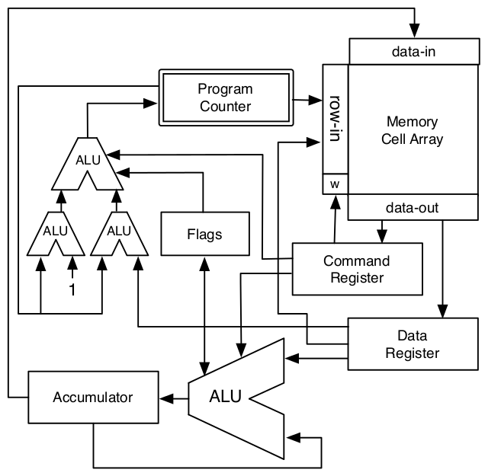
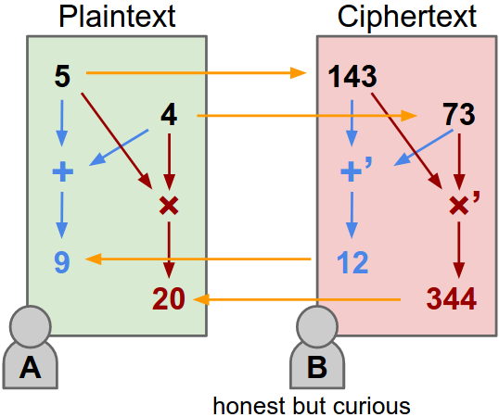
Secure Remote Computing
Michael Brenner, Jan Wiebelitz et al. „A smart-gentry based software system for secret program execution“.
Background
Fully Homomorphic Encryption
Notes:
limited (especially computational complexity of crypto scheme)

Slide 6
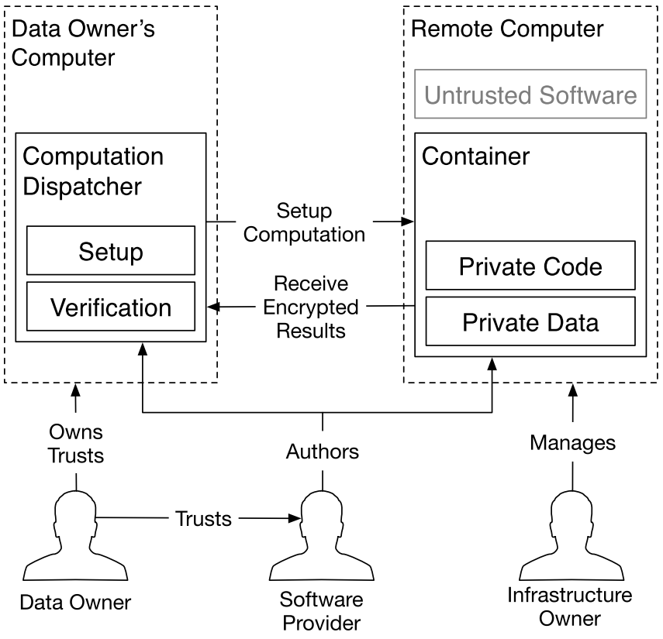
Secure Remote Computing
Victor Costan and Srinivas Devadas. „Intel SGX Explained“.
Background
Notes:
container: protects payload from untrusted software (infrastructure owner, attackers, …)

Slide 7
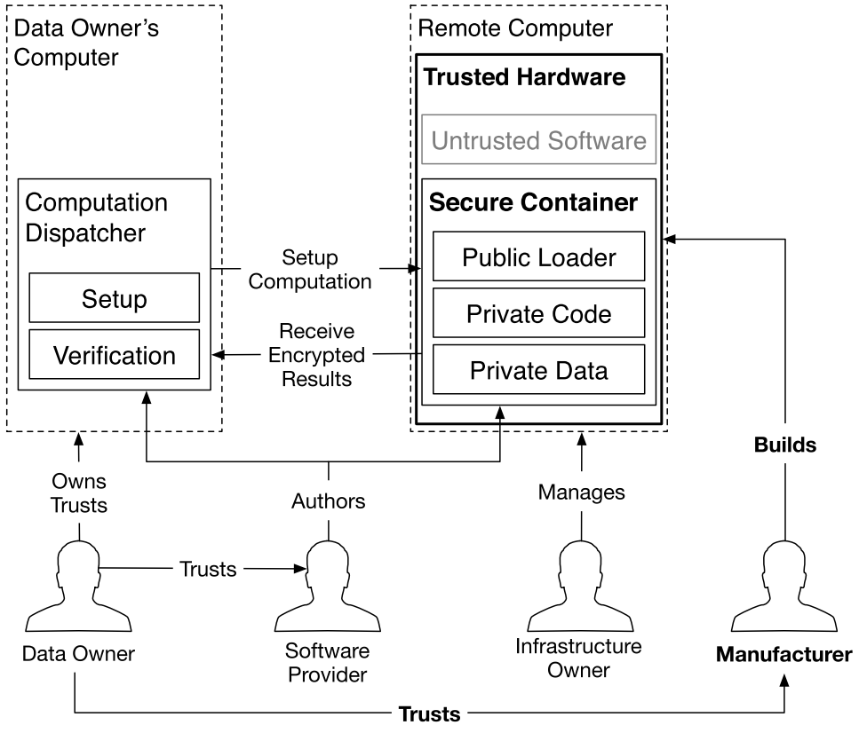
Trusted Computing
Victor Costan and Srinivas Devadas. „Intel SGX Explained“.
Background
Notes:
container secured by trusted hardware
new trust relationship
trusted = zuverlässig

Slide 8
Trusted Computing
Victor Costan and Srinivas Devadas. „Intel SGX Explained“.
Background
Setup
Notes:
setup: is secure container correct (trustworthy)?
-> software attestation

Slide 9
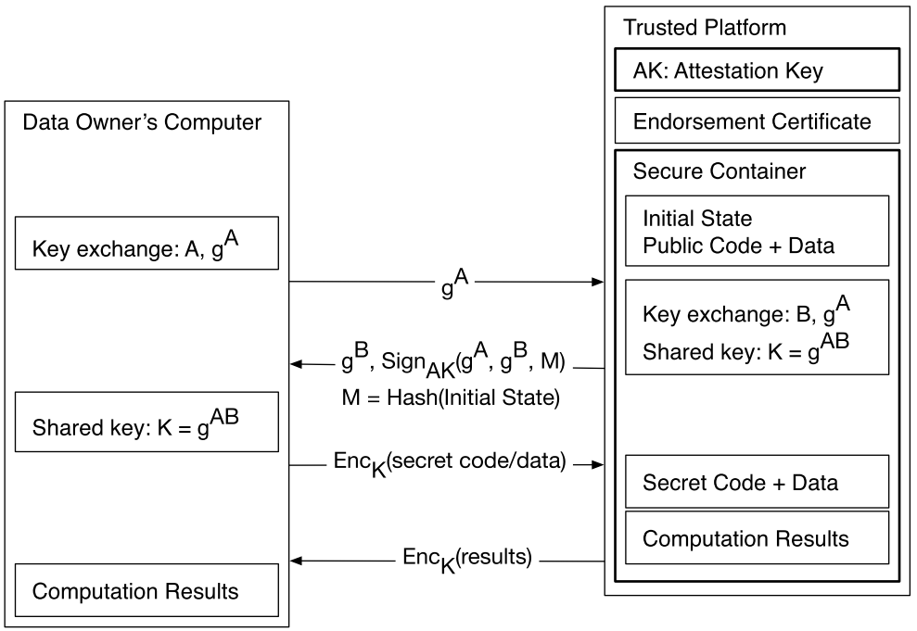
Software Attestation
Victor Costan and Srinivas Devadas. „Intel SGX Explained“.
Background
Notes:
beglaubigen

Slide 10
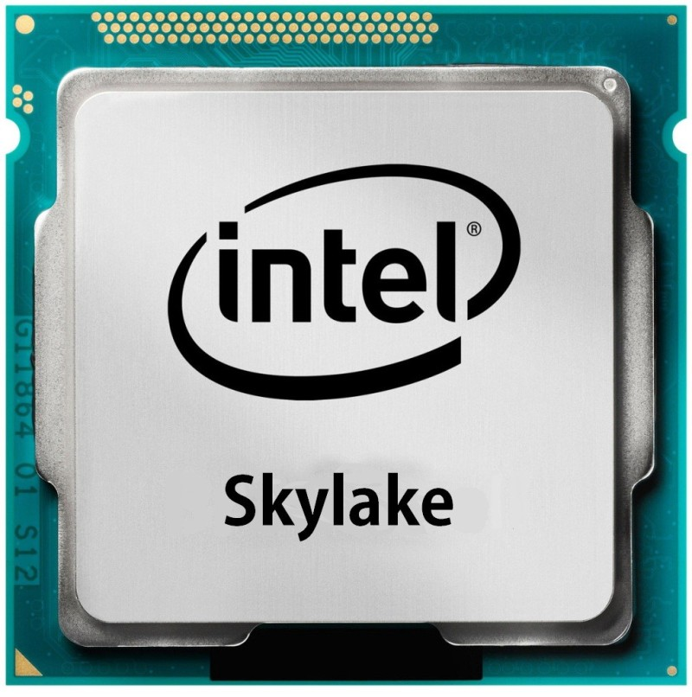
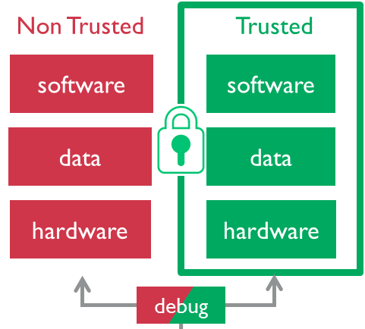
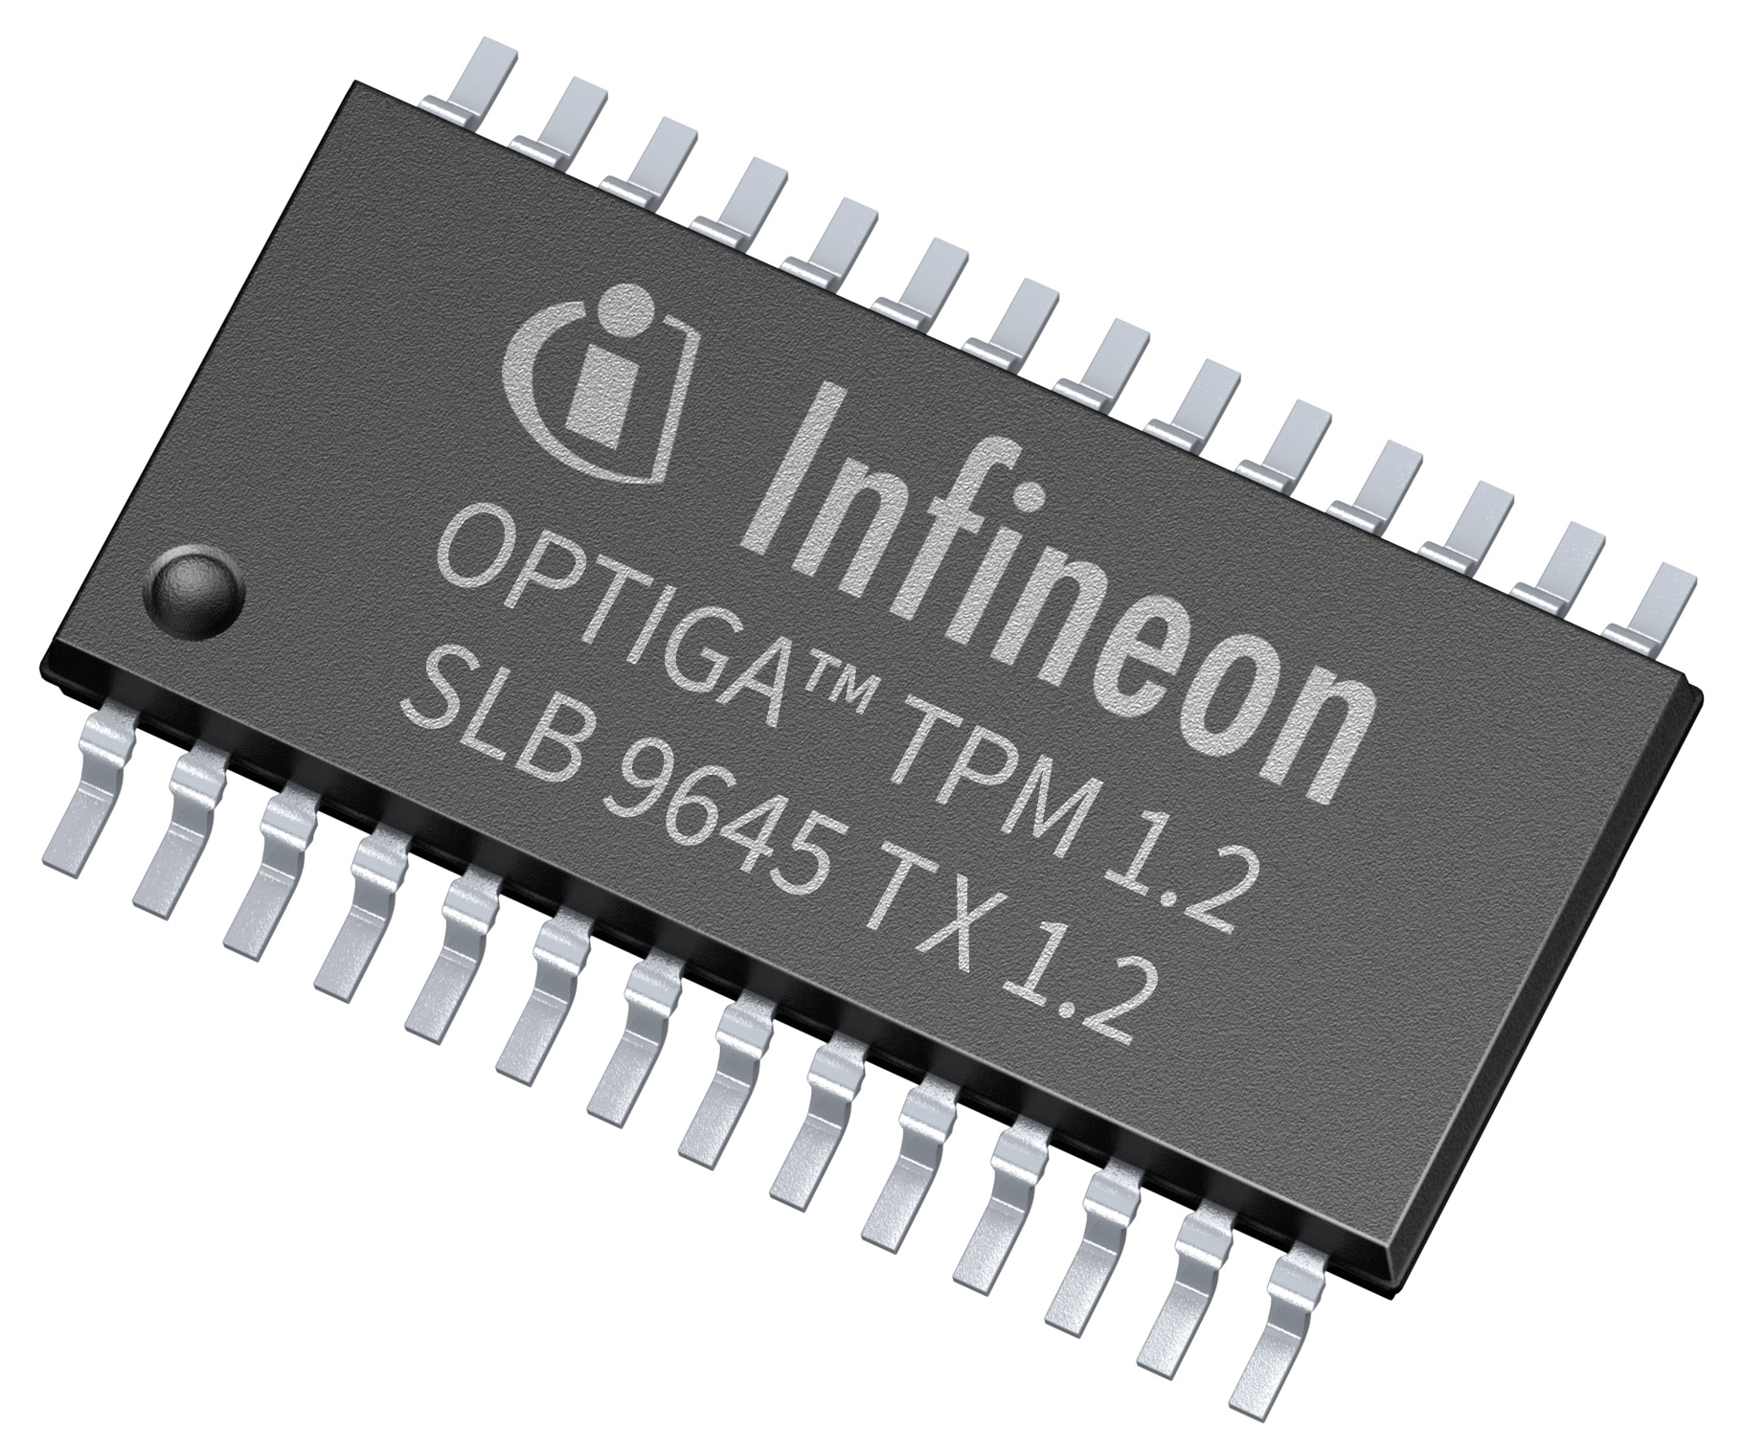
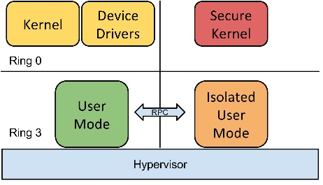
Commercial Solutions
Background
Intel SGX
ARM TrustZone
Trusted Platform Module
Windows Isolated User Mode (IUM)
2004?
2009
2015
2016
Notes:
not complete
TrustZone: split personality (system bus bit)
TPM: crypto co-processor
TXT: DRTM
SGX: new instruction set, mostly microcode
https://trustedcomputinggroup.org/membership/certification/tpm-certified-products/

Slide 11
Commercial Solutions
Background
tech- nology | concept | granularity | TCB | limitations | security | # of TEEs
TPM | security module (coprocessor) as root of trust for measured launch | entire software stack (BIOS, OS, all apps) | entire software stack + hardware | TPM is slow, entire software stack measured (delicate) | system is in guaranteed state (remote attestation) | 1
Intel TXT, AMD SVM | late loading of trusted app (requires TPM) | trusted app (typically VMM) | trusted app + hardware (+ loaded VMs) | late load is “expensive”, TPM is slow, (entire VM still in TCB) | trusted app is in guaranteed state (remote attestation) | 1
TrustZone | system split into normal and secure worlds via bus signal (incl. memory, peripherals) | entire secure world software stack | secure world software + world switching SW + hardware | single secure world | normal world cannot access secure world, secure world boots first | 1
Windows IUM | software (hypervisor) based version of TrustZone | applications | hypervisor + secure Kernel | limited to Windows, Hypervisor based, isolation of secure apps | no attestation, hypervisor enforces separation | 1
SGX | secure memory enclaves within process | enclave (security sensitive part of application) | enclave code + processor package | licensing, security issues | enclave is in guaranteed state (remote attestation), enclave memory is protected | n

Slide 12
Research Landscape: Enclaves (like SGX)
Background
 | HW¹ | VMM²-based | attestation | data sealing | trusted I/O | parallelism | comments
SGXª | SGX |  | X | X |  | X | CPU extensions, PAL memory encrypted in DRAM
Oasis^{b} | CPU |  | X | X |  |  | like SGX, but without DRAM encryption use cache-as-ram for secrets
TLR^{c} | TZ³ |  | ⁴ | X |  | X | .NET containers in secure world no trusted I/O: don’t want drivers in TCB
Flicker^{d} | TPM |  | X | X |  |  | PAL runs in secure execution mode (Intel TXT/AMD SVM way to dynamically establish secure environment) -> slow/limited
TrustVisor^{e} | TPM | X | X | X |  | X | PALs and legacy each in own virtual guest memory provides virtual TPM to each PAL
Fides^{f} | TPM | X |  |  |  |  | secure kernel runs PALs (shared memory between PALs) like a software version of TrustZone
¹ hardware foundation
² virtual machine monitor / hypervisor
³ TrustZone
⁴ possible, but not implemented

Slide 13
Research Landscape: Applications (like IUM)
Background
 | HW¹ | VMM²-based | attestation | data sealing | trusted I/O | parallelism | comments
GP TEE³ | - |  |  | X | X | X | reference model, maps well to TrustZone implementations exist for Android (Trustonic)
Haven | SGX |  | X | X |  | X | unmodified applications with library OS in enclave protects from Iago attacks by OS
InkTag | - | X |  |  |  | X | trusted hypervisor monitors OS
MiniBox | TPM | X | X | X |  | X | TrustVisor for entire application (also provides virtual TPM) adds sandbox: OS protected as well
¹ hardware foundation
² virtual machine monitor / hypervisor
³ GlobalPlatform reference model for Trusted Execution Environments: describes TEE internal and external API for building trusted applications

Slide 14
Research Landscape: Virtual Machines (like TPM/TXT)
Background
 | HW¹ | VMM²-based | attestation | data sealing | trusted I/O | parallelism | comments
CloudVisor | TPM | X | (X)³ |  |  | X | small monitor underneath VMM (nested virtualization) enforces isolation
Nova |  | X |  |  |  | X | µ-hypervisor built from scratch decomposed like µ-kernel, principle of least privilege
NoHype | ⁴ | (X) |  |  | (X) | X | static resource allocation: 1 VM per core, static memory slice no hypervisor interaction while executing needs hardware features that no product offers
vTPM | TPM | X | X | X |  | X | provide virtual TPM to each VM vTPM can be stored and migrated
¹ hardware foundation
² virtual machine monitor / hypervisor
³ attestation only of CloudVisor monitor, not of individual VMs
⁴ hardware virtualization support by CPU (extended page tables, VMM ring -1), devices with virtualization support

Slide 15

Intel SGX Programming Model
Background
attestation
+ key exchange
untrusted wrapper
client
enclave 1
enclave 3
enclave 2

Slide 16
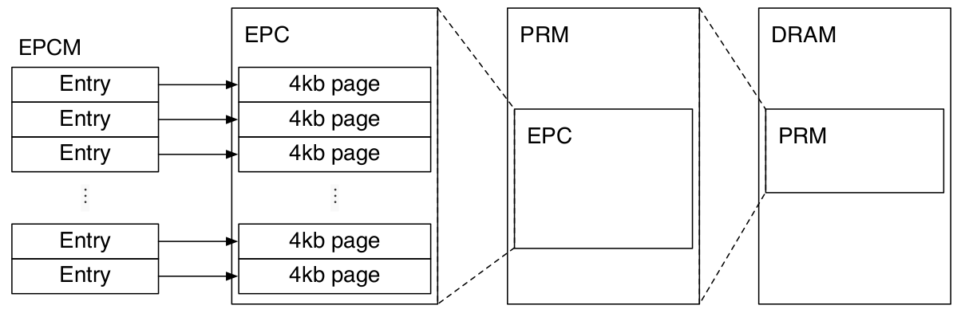
Intel SGX
Victor Costan and Srinivas Devadas. „Intel SGX Explained“.
Background
instruction set extension (mostly microcode)
OS schedules resources

Slide 17
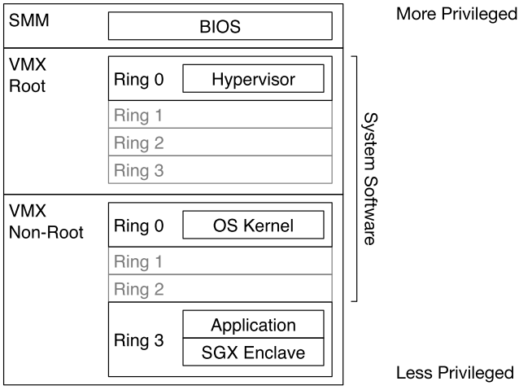
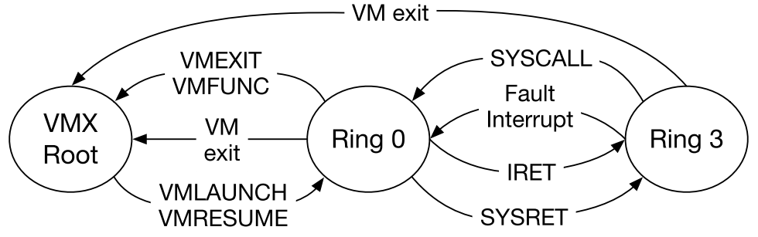
Intel SGX
Victor Costan and Srinivas Devadas. „Intel SGX Explained“.
Background
instruction set extension (mostly microcode)
OS schedules resources
orthogonal to existing virtualization
x86 privilege levels
virtual memory
SGX Enclave

Slide 18
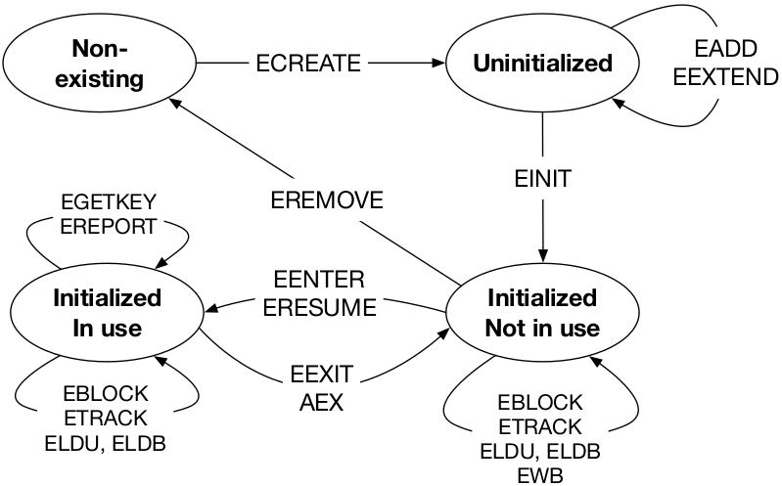
Intel SGX
Victor Costan and Srinivas Devadas. „Intel SGX Explained“.
Background
instruction set extension (mostly microcode)
OS schedules resources
orthogonal to existing virtualization
x86 privilege levels
virtual memory
Notes:
Launch Enclave: EINIT Token

Slide 19
Intel SGX SDK
Intel® Software Guard Extensions Evaluation SDK
Background
C, C++
interface: ecalls, ocalls
.edl -> stub (pointer handling)
no syscalls inside enclave
// demo.edl
enclave {
trusted {
void get_secret([out] secret_t* secret);
void get_secret([user_check] secret_t* secret);
};
untrusted {
void dump_secret([in] const secret_t* secret);
};
};
Notes:
no I/O

Slide 20
Related Work
Secure Databases
Applications secured with SGX
Application Partitioning Design Space

Slide 21
Secure Databases Design Space
Arvind Arasu, Ken Eguro et al. „Querying Encrypted Data (Tutorial)“
Related Work
 |  | encryption scheme
secure location |  | non homomorphic | partially homomorphic | fully homomorphic
 | - |  | CryptDB | ?
 | client | Arx | Monomi
 | co-processor |  | TrustedDB
 | FPGA |  | Cipherbase
 | SGX | ? | ?

Slide 22
Intel SGX Applications
https://intelledger.github.io/introduction.html#proof-of-elapsed-time-poet
Felix Schuster, Manuel Costa et al. „VC3: Trustworthy data analytics in the cloud using SGX“.
Stefan Brenner, Colin Wulf et al. „SecureKeeper: Confidential ZooKeeper using Intel SGX“. Sergei Arnautov, Bohdan Trach et al. „SCONE: Secure linux containers with Intel SGX“.
Related Work
Proof of elapsed Time
Blockchain
Microsoft VC3
Verifiable Confidential Cloud Computing
in-band encrypted MapReduce
Secure Zookeeper
SCONE: Secure Linux Containers
user-level threading, syscall service workers
musl libc, transparent shielding
Notes:
VC3: in-band key exchange and verification
SCONE: musl libc, user level threading, async syscalls

Slide 23
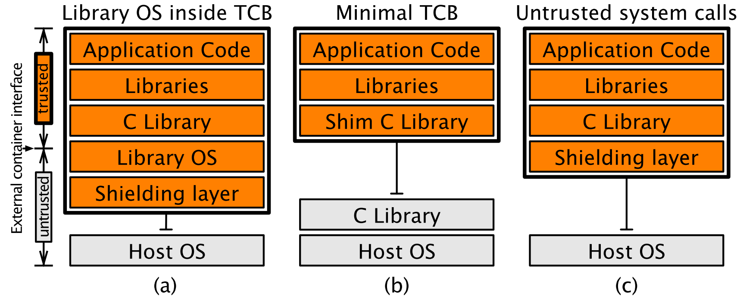
Enclave Interface Design Space
Sergei Arnautov, Bohdan Trach et al. „SCONE: Secure linux containers with Intel SGX“.
Related Work
Notes:
a) Haven / LKL
- large TCB
b) libc outside
- wide interface
c) libc inside
+ protect calls: read, write, send, recv

Slide 24



Application Separation Design Space
Ahmad Atamli-Reineh and Andrew Martin. „Securing application with software partitioning: A case study using SGX“
Related Work
a) whole application | b) separate functionality | c) separate secrets
Notes:
SSL library
data per connection
separation via enclaves vs. in enclaves
session key, private key

Slide 25
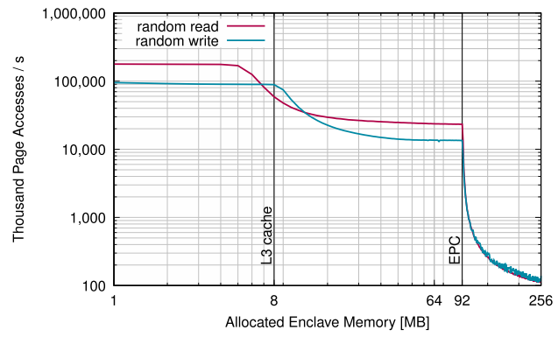
Application Memory Management
Stefan Brenner, Colin Wulf et al. „SecureKeeper: Confidential ZooKeeper using Intel SGX“.
Related Work
x5.5
x200
Notes:
Kapitza
EPC: 128MB (mgmt overhead)

Slide 26
Scope
My Thesis
comparison of available solutions (qualitative)
design decisions (SGX)
case study (DBMS)

Slide 27
Case Study: KissDB
https://github.com/adamierymenko/kissdb
My Thesis
key value store
vanilla C
~400 SLOC
test
use case for SGX Lib https://github.com/ftes/sgx-lib
rapid migration helper (libc shim)
missing
attestation + secure communication
extract only security critical functionality into enclave?
Notes:
2016: SDK just released, aweful documentation, no helper libraries

Slide 28
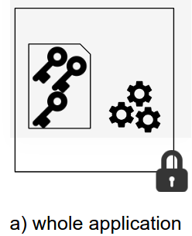
Case Study: KissDB
My Thesis
kissdb_sgx
kissdb_u
kissdb_t
database file
open()
create
close()
destroy
plaintext metadata
encrypted payload
put()
get()
Notes:
entire application

Slide 29
Case Study: KissDB File
My Thesis
header
KDB2
number of hash-table entries
key size (bytes)
value size (bytes)
key: 53, value: ...
key: 317, value: …
...
key: 704, value: ...
hash table page 1
hash | offset
0
1
...
next page
data block 1
encrypted
hash table page 2
data block 2
Notes:
new page added if bucket in previous is full
new item appended to end of file
metadata not encrypted

Slide 30
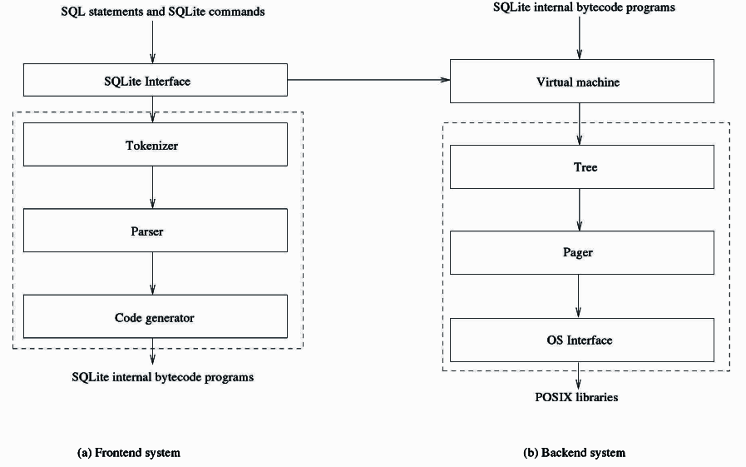
SQLite
Sibsankar Haldar. „SQLite Database System Design and Implementation“
My Thesis
113K SLOC
hardening approaches
Virtual Machine
User Defined Functions

Slide 31
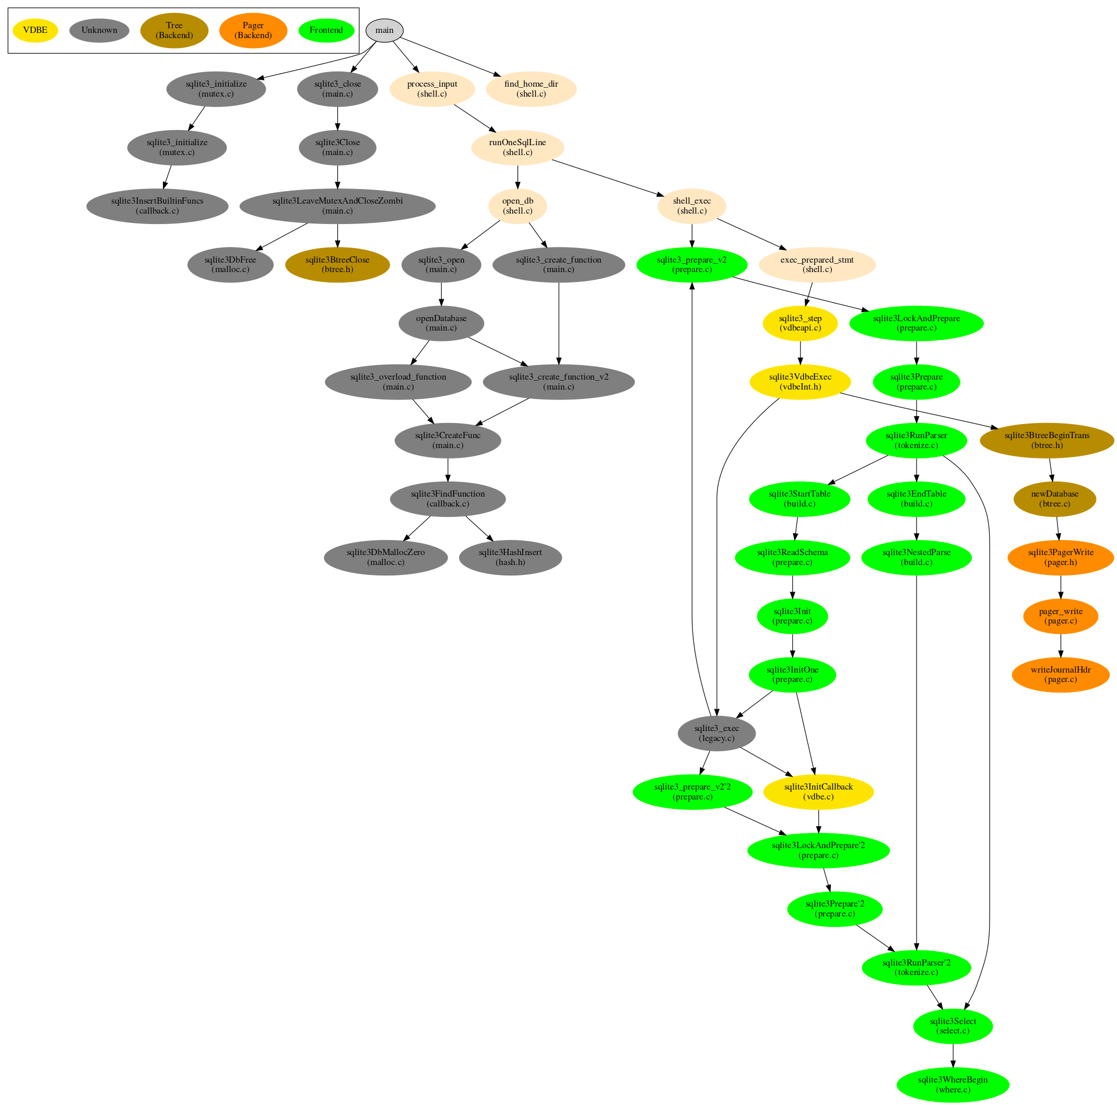
SQLite: Extracting the Virtual Machine
My Thesis

Slide 32
Conclusion
My Thesis
timeline
implementation completed
if there was more time
implement SQLite approach
benchmarks
SGX + partially homomorphic encryption
attestation

Slide 33
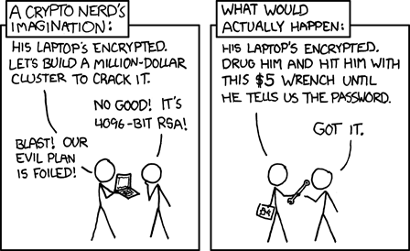
https://xkcd.com/538/

Slide 34
Backup

Slide 35
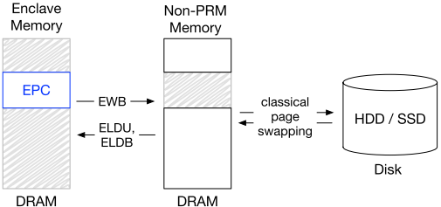
Intel SGX Two Stage EPC Paging
Victor Costan and Srinivas Devadas. „Intel SGX Explained“.

Slide 36
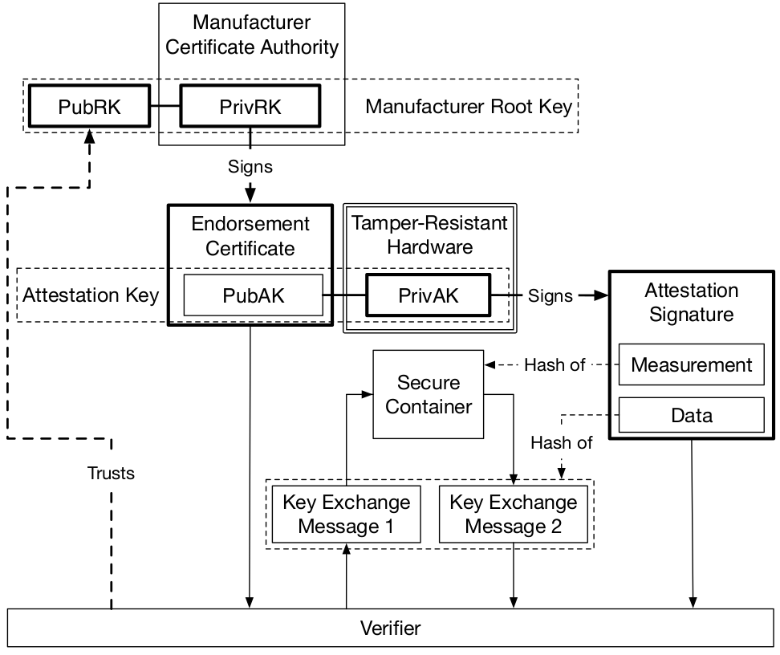
Software Attestation Chain of Trust
Victor Costan and Srinivas Devadas. „Intel SGX Explained“.

Slide 37
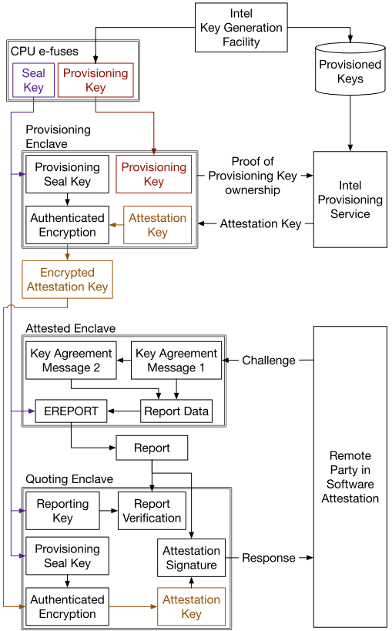
SGX Remote Attestation
Victor Costan and Srinivas Devadas. „Intel SGX Explained“.

Slide 38
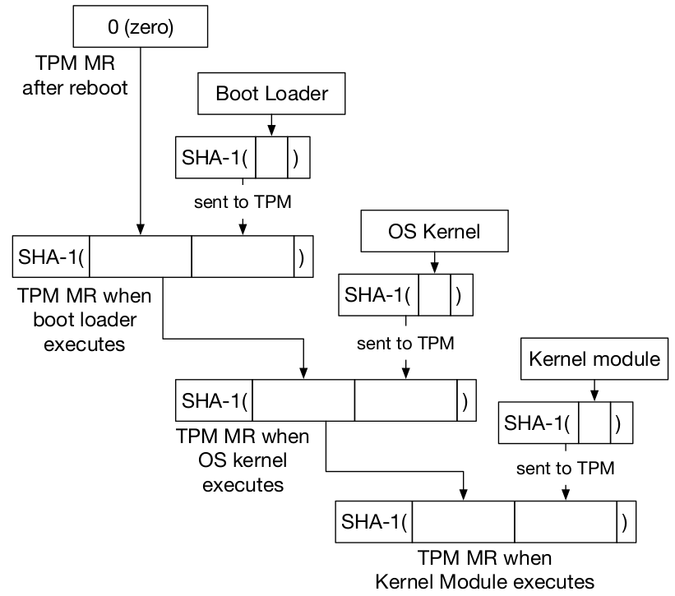
TPM SRTM
Dennis Kafura. Trusted Platform Module — Integrity Measurement, Reporting, and Evaluation.

Slide 39
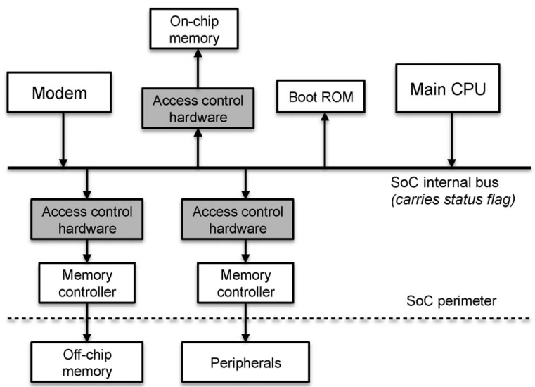
ARM TrustZone Access Control
J.-E. Ekberg, K Kostiainen et al. „Trusted Execution Environments on Mobile Devices“

Slide 40
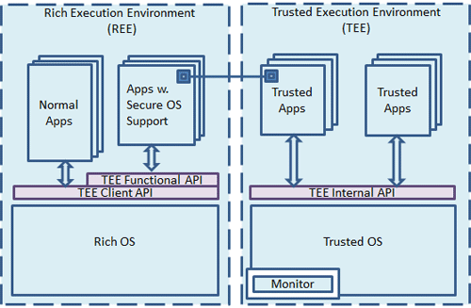
ARM TrustZone Worlds
ARM. Development of TEE and Secure Monitor Code.
Notes:
monitor: responsible for context switches between worlds

Slide 41
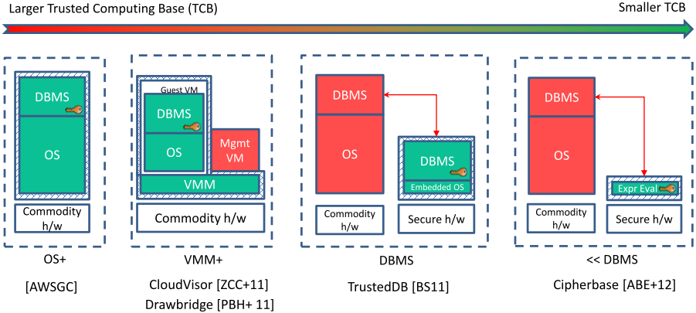
Secure Databases
Arvind Arasu, Ken Eguro et al. „Querying Encrypted Data (Tutorial)“
Related Work

Slide 42
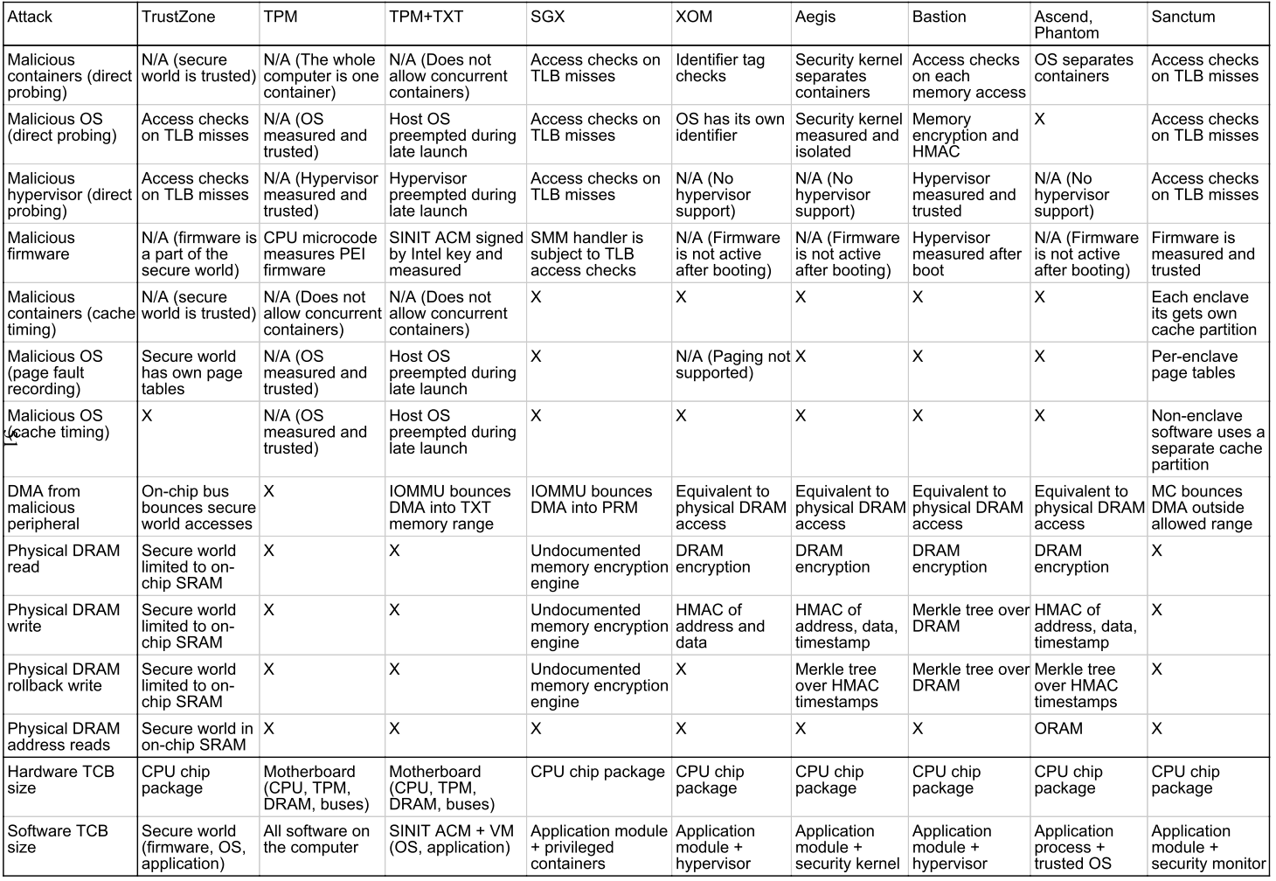
Security Features Overview
Victor Costan and Srinivas Devadas. „Intel SGX Explained“.

